Slide 1
How to Join Your Virtual Classroom
Getting Started

Slide 2
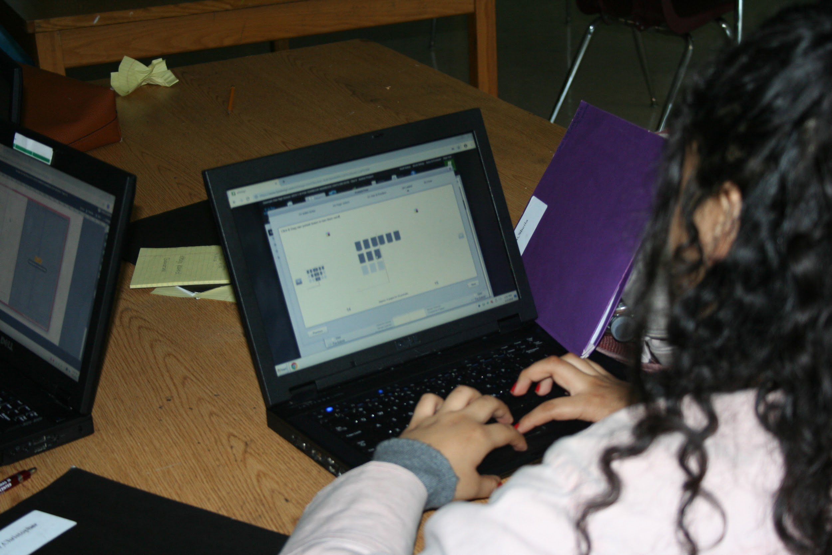
1. Turn on your computer.
Make sure it is charged.
Make sure you have room to work.
Keep your computer away from dust, liquids, and crumbs.

Slide 3
2. Log In
To log in, enter your school E-mail address as your user ID.
Enter your password.
If you don’t remember your student password, email: wbaker@bamberg2.org for help.

Slide 4
3. Open Google Classroom
Make sure you are in Chrome.
Find the small grid in the top right of your screen and click on it.
Scroll down until you see “Classroom”
If you don’t see it, you will have to go to “more” and install it.

Slide 5
4. Join Your Class
Check your schedule to see which class is meeting.
If you don’t see an icon for that class, you will have to get the e-mail link that your teacher sent.
You can also join by entering the class code.
Click on the class that you want to join.

Slide 6
Find the Google Meet link for your class.
Click on this link to join your class.

Slide 7
4. Join the class meeting.

Slide 8
Camera and Mic
Once you are in the meeting, find the camera and mic icons, bottom center.
Turn off the mic by clicking it.
You can turn off the camera or leave it off for now.

Slide 9
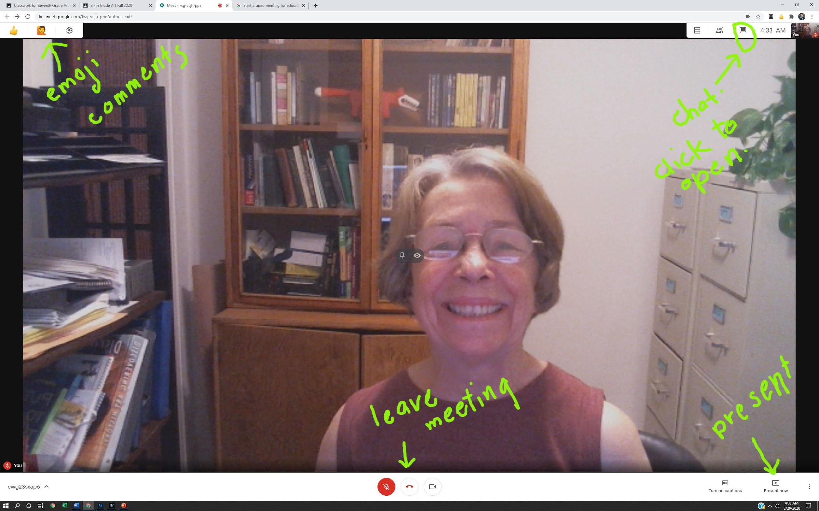
Watch and listen to the lesson.
Use the chat box to type in questions.
Use the emojis to comment.
You can change the page layout
If you are asked to present your work, find the “present” button.

Slide 10
Type questions or comments into chat.

Slide 11
Do the work assigned to you!

Slide 12
About Your Class Work:
Late work will only be accepted if the teacher OK’s it.
Failure to turn in work will result in a 0
You must log in to every class at the time it begins. You will not pass if you have 10 or more absences for the year.
Students not logged in will be counted as absent.
Your work will still be due.

